Slide 1


Objectives
In this session, you will learn to:
  Create an HTML Web page
  Work with styles

Slide 2
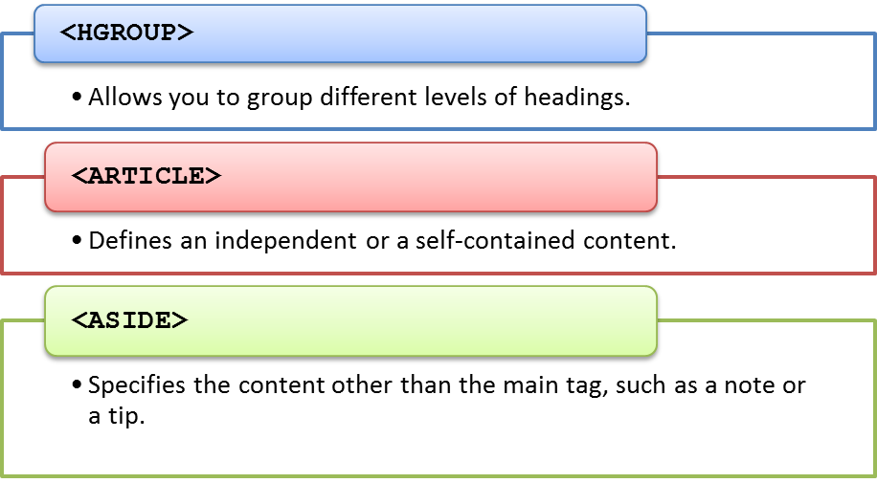
Exploring the <BODY> Tag
The semantic tags:
  Are used to provide better readability of Web pages to Web designers.
  Provided by HTML are:

Slide 3
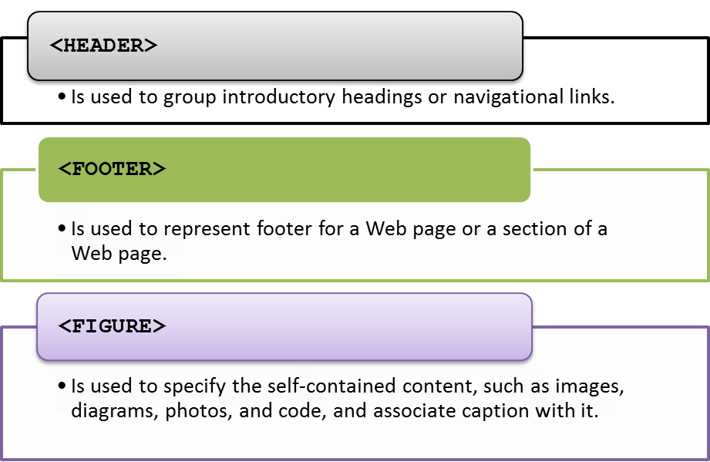
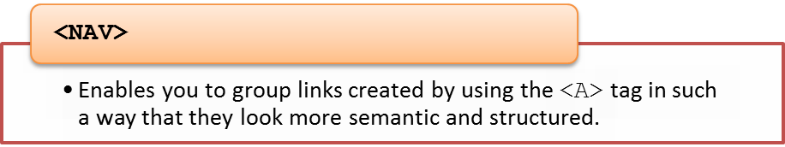
Exploring the <BODY> Tag (Contd.)

Slide 4
Just a Minute
Identify the attribute of the <AUDIO> tag that specifies that the audio will restart
playing, every time it has finished playing.
  loop
  controls
  src
  autoplay

Slide 5
Just a Minute (Contd.)
Solution:
  loop

Slide 6
Demo: Creating a Web Page
Problem Statement:
  You are a Web developer at BuildYourWeb Inc. You have been assigned the task of creating the home page for ShowOnWheels. The home page should be based on the following guidelines:
    It should display the organization logo.
    It should display some text describing about the company in paragraphs.
    It should also display names of various US cities, where ShowOnWheels is currently operating, in a list. This list should unfold when a user clicks the Currently Operating in text.
    It should provide links to other pages, such as About Us, Contact Us, and Upcoming Movies.
    It should display the images of latest movies.
    It should display a video clip showing the latest offers.
    It should link a style sheet.
    It should display the contact number so that users can call to enquire about any upcoming movie.
  Prerequisite: You need the ExternalStylesheet, images, and video folders, which contain the style sheet, images, and video clip required for performing this activity. In addition, you need the aboutus.html, contactus.html, and upcomingmovies.html files. Ask your faculty to provide the same and save these files and folders at the following location:
  D:\HTML\ShowOnWheels

Slide 7
Demo: Creating a Web Page (Contd.)
Solution:
  To create the required Web page, you need to perform the following tasks:
1. Create the home page.
2. Add heading and logo to the home page.
3. Create the links.
4. Add images and a video clip.
5. Add paragraphs and a list of cities.
6. View the home page.

Slide 8
Working with Styles
Cascading Style Sheet (CSS):
  Is a collection of styles used to change the appearance of HTML elements on
  Web pages.
  Defines a set of standard rules that provide better control over the page layout
  and appearance.
  Is used to enforce consistent display standards across all the Web pages of the
  website.
  Use the animation, HTML_02_Applying_Styles_Using_CSS.swf, to understand the concept of styles.

Slide 9
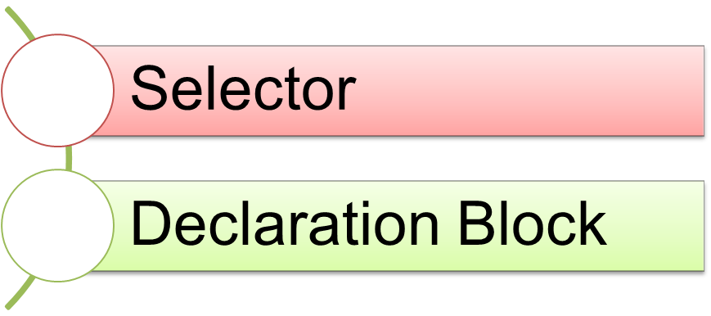
Identifying the Syntax of CSS
  CSS allows the creation of one or more rules for defining the style
  characteristics of HTML elements.
  Each CSS rule consists of the following parts:

Slide 10
Identifying the Syntax of CSS (Contd.)
  You can use the following syntax to define a CSS rule:
    selector
    {
    //Declaration Block
    property: value;
    }

Slide 11
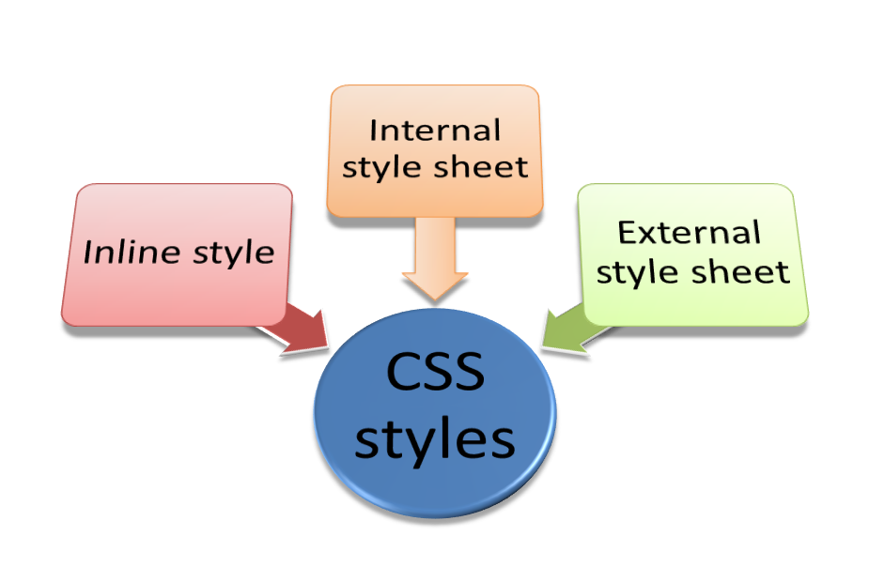
Identifying the Types of Style Sheets
CSS styles can be broadly classified into the following categories:

Slide 12
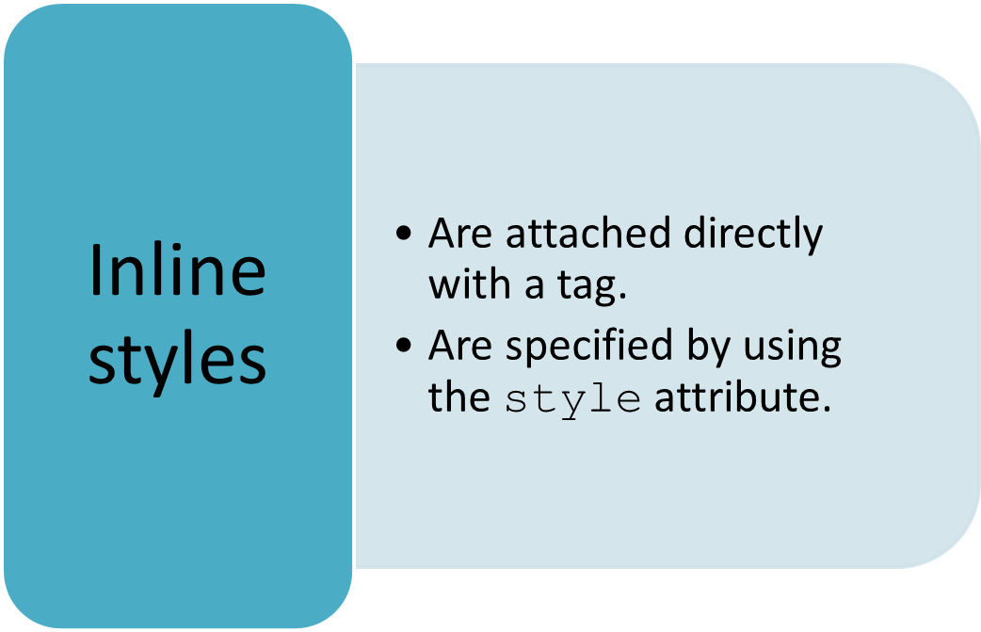
Identifying the Types of Style Sheets (Contd.)
Inline styles:

Slide 13
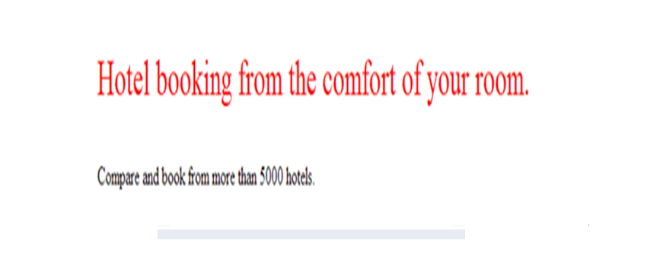
Identifying the Types of Style Sheets (Contd.)
  For example:
    <!DOCTYPE HTML>
    <HTML>
    <BODY>
    <P style="font-size: 24pt; color: red">Hotel booking from the comfort of your room.</P>
    <P>Compare and book from more than 5000 hotels. </P>
    </BODY>
    </HTML>
Output

Slide 14
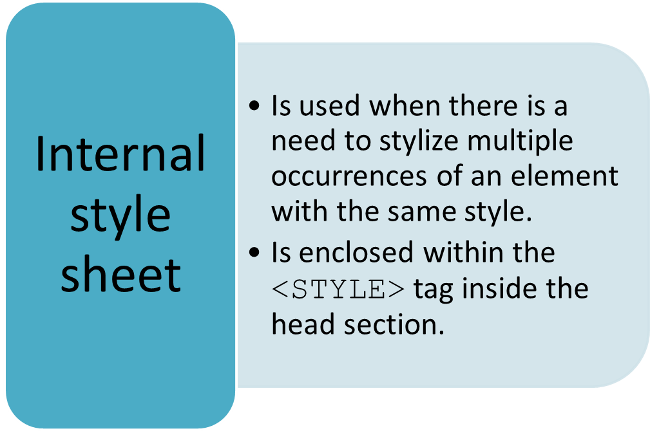
Identifying the Types of Style Sheets (Contd.)
Internal style sheet:

Slide 15
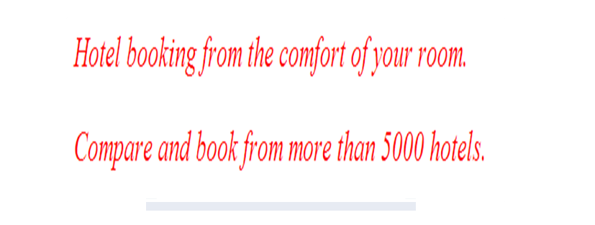
Identifying the Types of Style Sheets (Contd.)
  For example:
    <HTML>
    <HEAD>
    <STYLE type="text/css">
    p
    {
    color:red;
    font-size:20pt;
    font-style:italic;
    }
    </STYLE>
    </HEAD>
    <BODY>
    <P> Hotel booking from the comfort of your room.</P>
    <P> Compare and book from more than 5000 hotels.</P>
    </BODY>
    </HTML>
Output

Slide 16
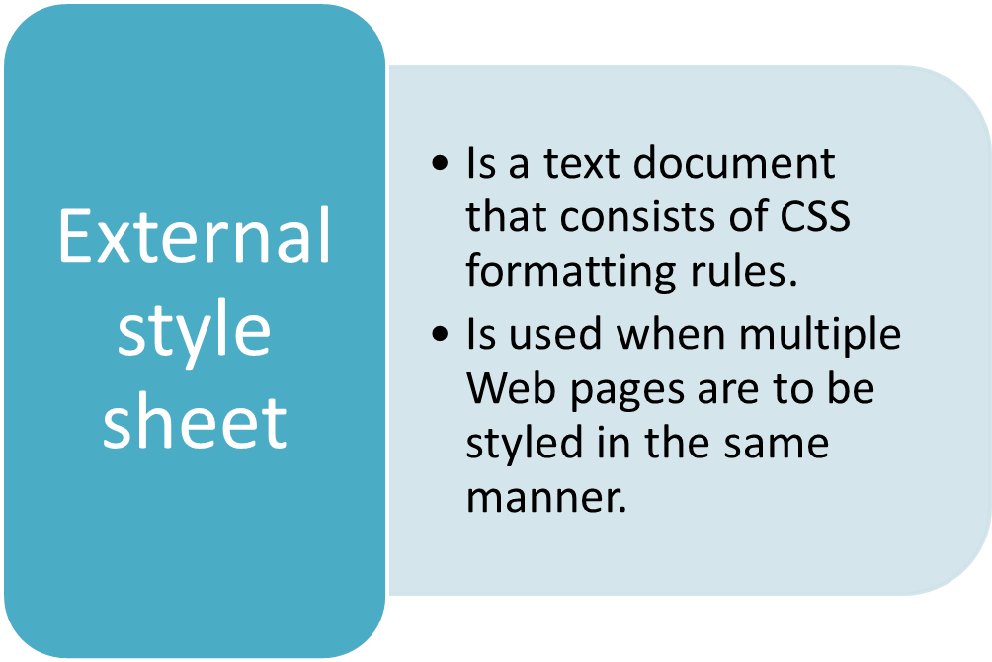
Identifying the Types of Style Sheets (Contd.)
External style sheet:

Slide 17



Identifying the Types of Style Sheets (Contd.)
  For example:
externalstyle.css
p
{
color:red;
font-size:20pt;
font-style:italic;
}
h1
{
color:blue;
font-size:25pt;
font-weight:bold;
}
<HTML>
<HEAD>
<TITLE> An External Style Sheet </TITLE>
<LINK type="text/css" rel="stylesheet" href="externalstyle.css" />
</HEAD>
<BODY>
<H1> Hotel booking from the comfort of your room. </H1>
<P> Compare and book from more than 5000 hotels. </P>
</BODY>
</HTML>
Output

Slide 18
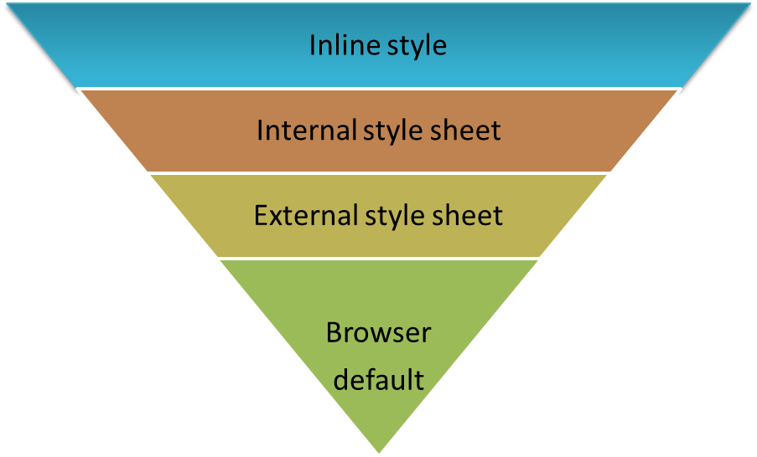
Applying Multiple Style Sheets
You may set the properties for the same selector in multiple style sheets.
In such a case, the style that is most specific to the element will be used to
stylize the element.
The following list displays the priority of style sheets in descending order:

Slide 19
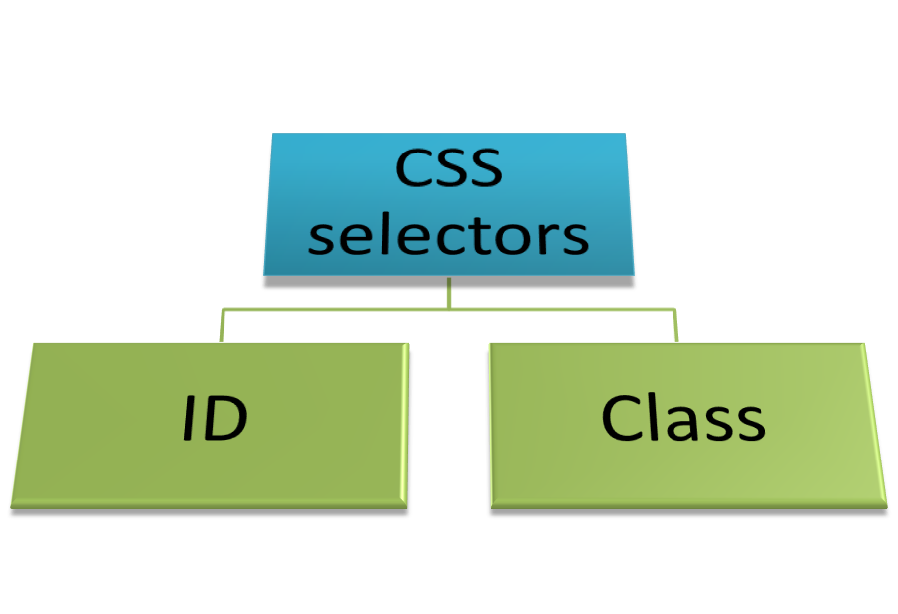
Identifying CSS Selectors
The user-defined CSS selectors can be classified into the following categories:

Slide 20

Identifying CSS Selectors (Contd.)
An ID selector:
  Is used to identify an element that you need to style differently from the rest
  of the page.
  Is defined by using the hash symbol (#).
  The following embedded Notepad file contains the code to show the use of an ID selector:

Slide 21

Identifying CSS Selectors (Contd.)
A class selector:
  Is used when there is a need to apply the same style on different types of elements.
  Is defined by using a dot (.).
  The following embedded Notepad file contains the code to show the use of a
  class selector:

Slide 22
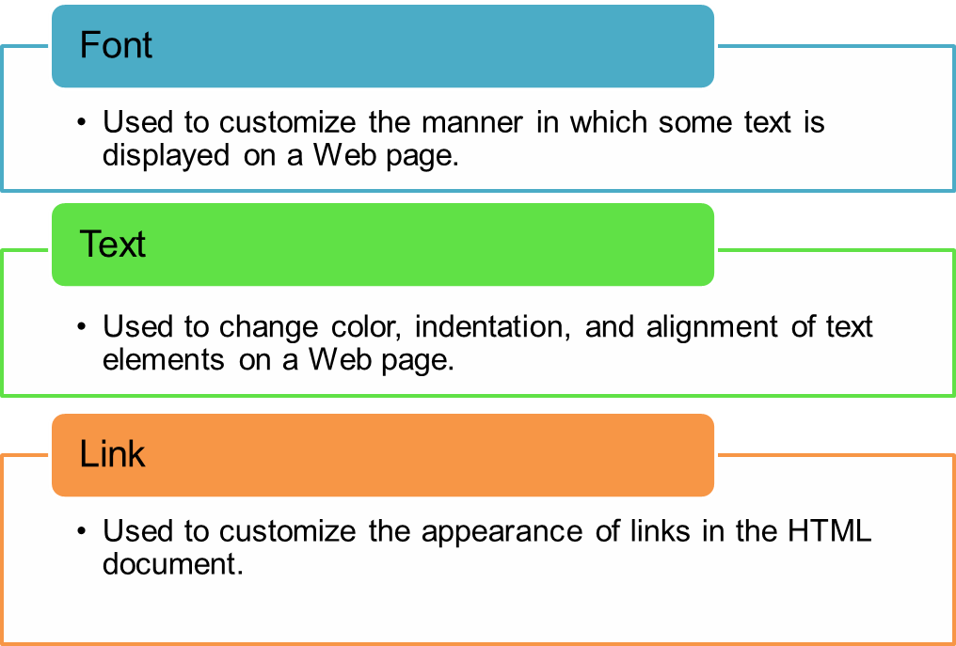
Styling HTML Elements
CSS properties:
  Represent customizable characteristics of the HTML elements.
  Can be classified into the following categories:

Slide 23
Summary
In this session, you learned that:
  The semantic tags provided by HTML are:
    <HGROUP>
    <ARTICLE>
    <ASIDE>
    <HEADER>
    <FOOTER>
    <NAV>
    <FIGURE>
  CSS is a collection of styles that allow you to change the appearance of HTML elements on Web pages.
  CSS allows the creation of one or more rules for defining the style characteristics of HTML elements.
  Inline styles are attached directly with the tag in the HTML document. They are specified by using the style attribute inside an element declaration in the HTML document.
  An internal style sheet is used when there is a need to stylize the multiple occurrences of an element on a Web page with the same style.

Slide 24
Summary (Contd.)
  An external style sheet is used when multiple Web pages are to be styled in the same manner to ensure the consistent look and feel across the entire website.
  An ID selector is used to identify an element that you need to style differently from the rest of the page. An ID selector is defined by using the hash symbol (#).
  A CSS style can be applied to a group of elements by using the class selector. The class selector is defined by using a dot (.).
  A CSS property represents a characteristic of the HTML element that can be customized.
  The font property is used to customize the manner in which some text is displayed on a Web page.
  The text property is used to change color, indentation, and alignment of text elements on a Web page.
  The link property is used to customize the appearance of links in the HTML document.

